Slide 1
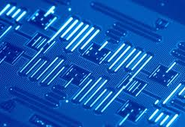
Numerical analysis of protected qubits​
TR CONTROL: ​ ​ Gabriel Vandersippe,​ Eliot Delachaux
Source : IBM (via The Quantum Insider)
1

Slide 2
Outline
Brief introduction to superconducting circuits
Project Motivations
Results with Krylov techniques (Eliot)
Results with Tensor Networks (Gabriel)
Using Python packages : NumPy, QuTiP, SCQubits, MatPlotLib, SciPy, JAX, Pandas
Using Julia packages :
ITensors, ITensorMPS, KrylovKit, CairoMakie, LinearAlgebra, HypergeometricFunctions, CSV, DataFrames
2

Slide 3
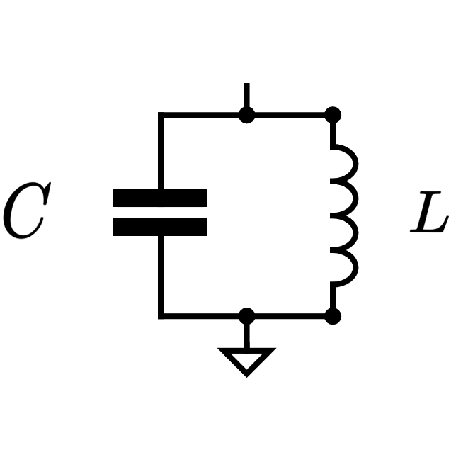
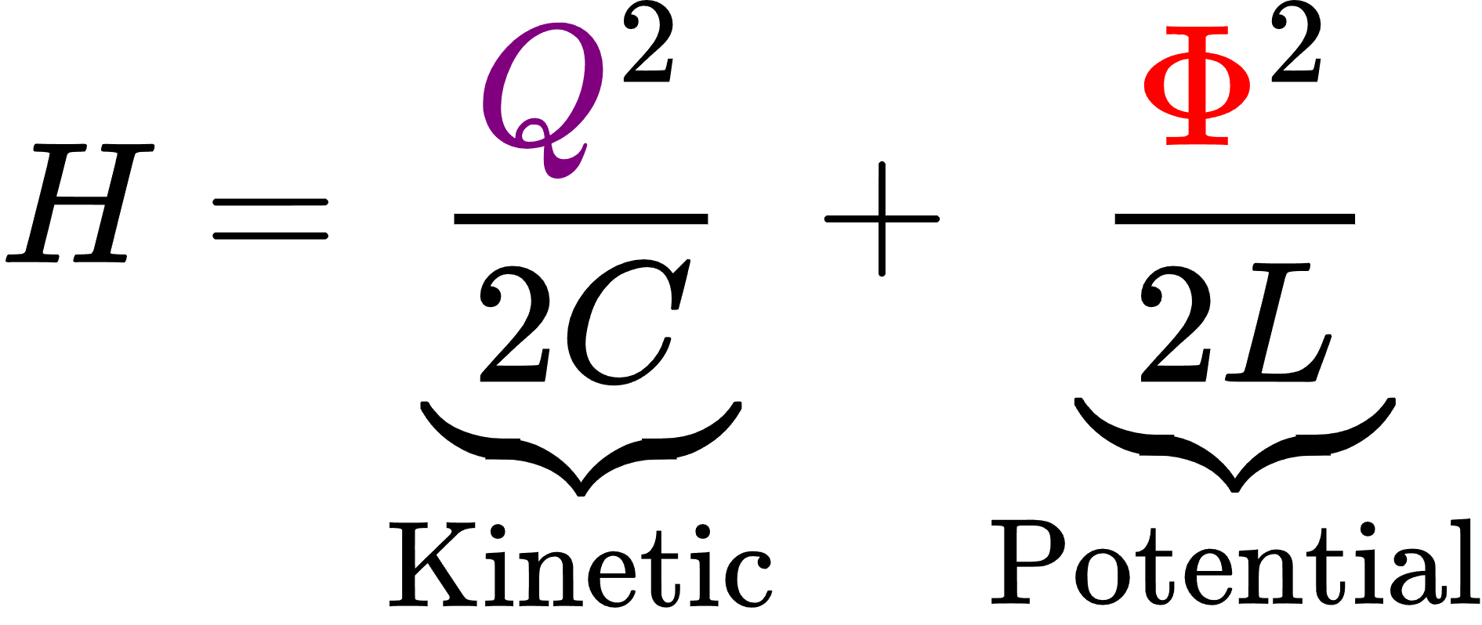
Introduction : Harmonic Oscillator
3
Blais, et al., Reviews of Modern Physics 93 (2), 025005 (2021)

Slide 4
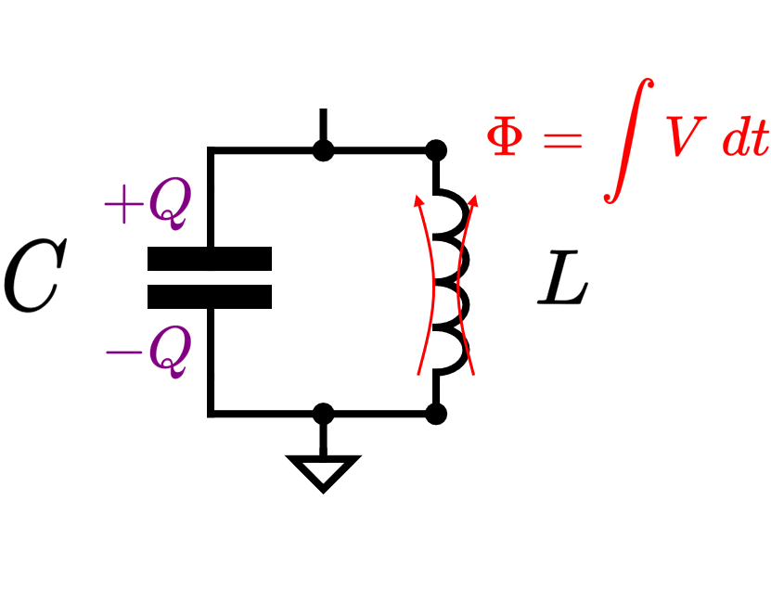
Introduction : Harmonic Oscillator
4
Blais, et al., Reviews of Modern Physics 93 (2), 025005 (2021)

Slide 5
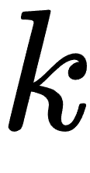
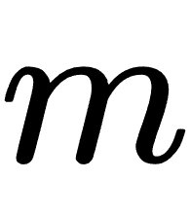
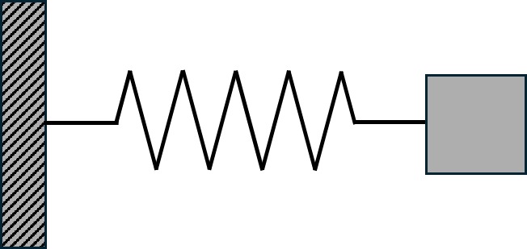
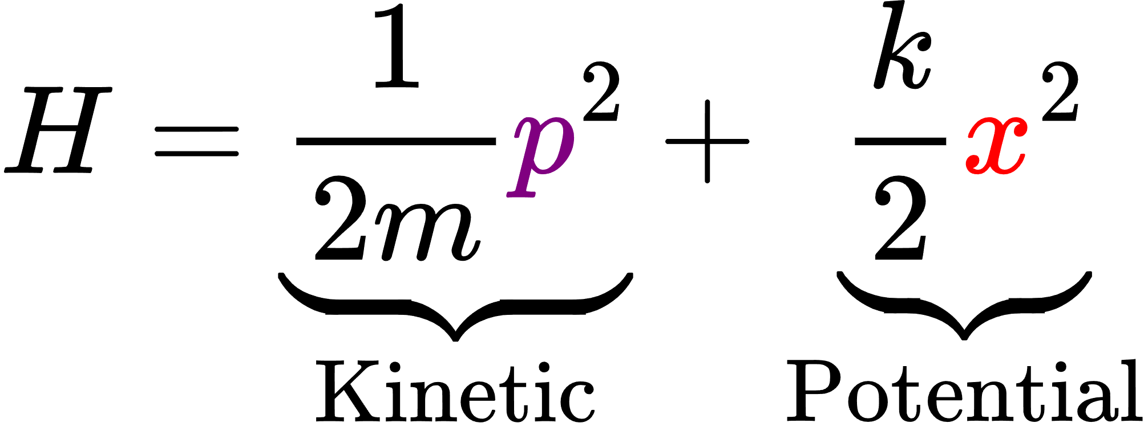
Introduction : Harmonic Oscillator
5
Blais, et al., Reviews of Modern Physics 93 (2), 025005 (2021)

Slide 6
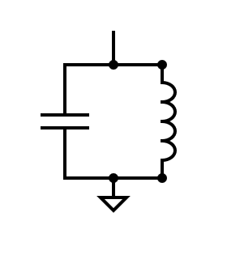
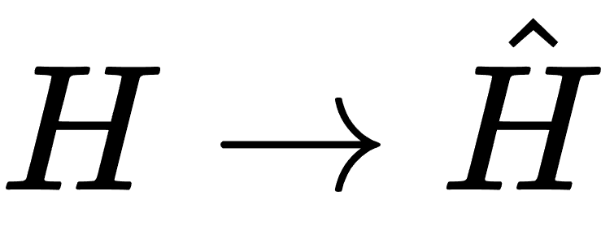
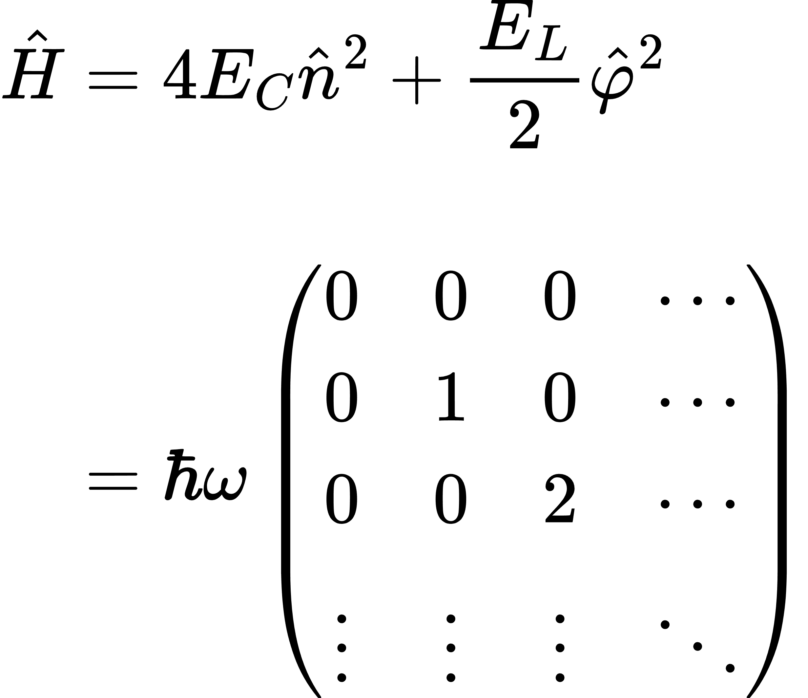
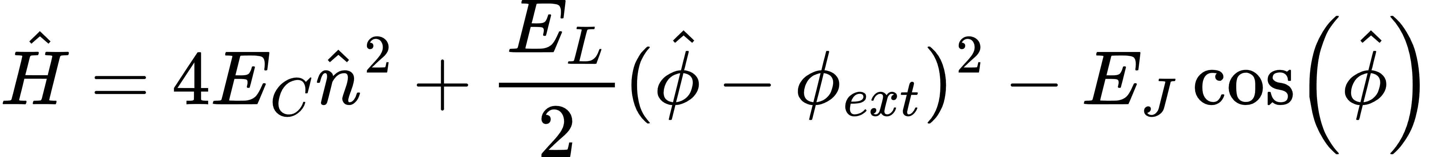
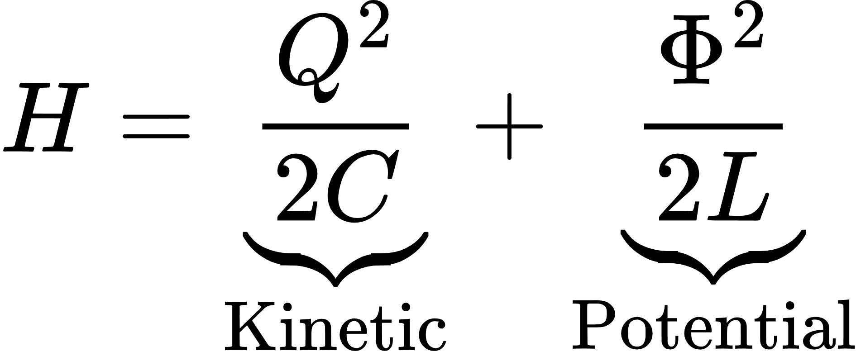
Quantizing the Harmonic Oscillator
Correspondence principle :
Operator
Hamiltonian :
6
Blais, et al., Reviews of Modern Physics 93 (2), 025005 (2021)

Slide 7
Quantizing the Harmonic Oscillator
Correspondence principle :
Operator
Hamiltonian :
Infinite basis :​
7
Blais, et al., Reviews of Modern Physics 93 (2), 025005 (2021)

Slide 8
Quantizing the Harmonic Oscillator
Correspondence principle :
Operator
Hamiltonian :
Infinite basis :​
cutoff
8
Blais, et al., Reviews of Modern Physics 93 (2), 025005 (2021)

Slide 9
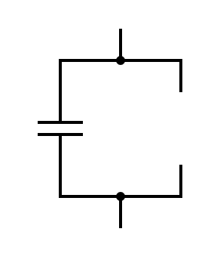
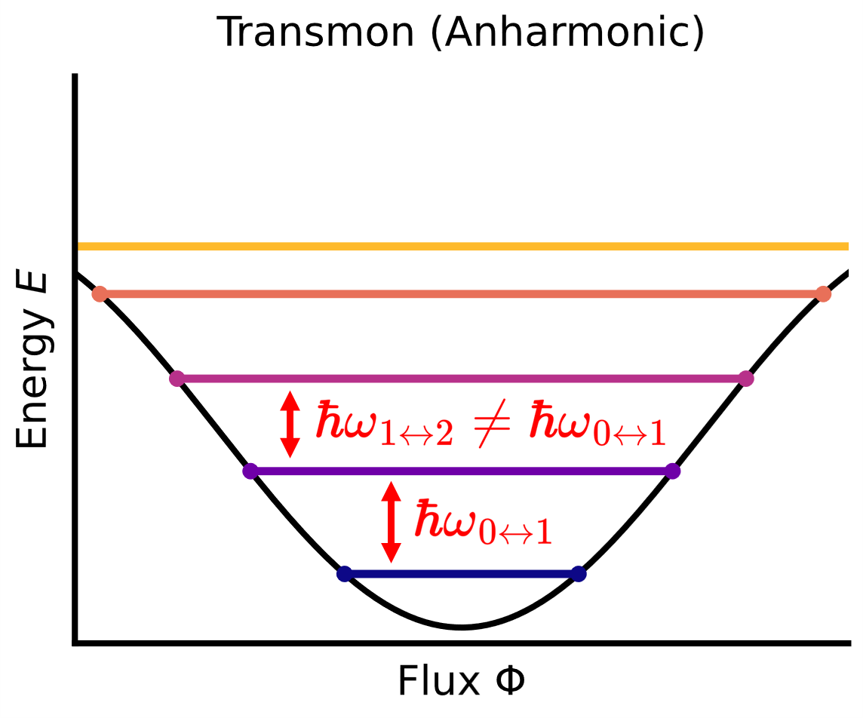
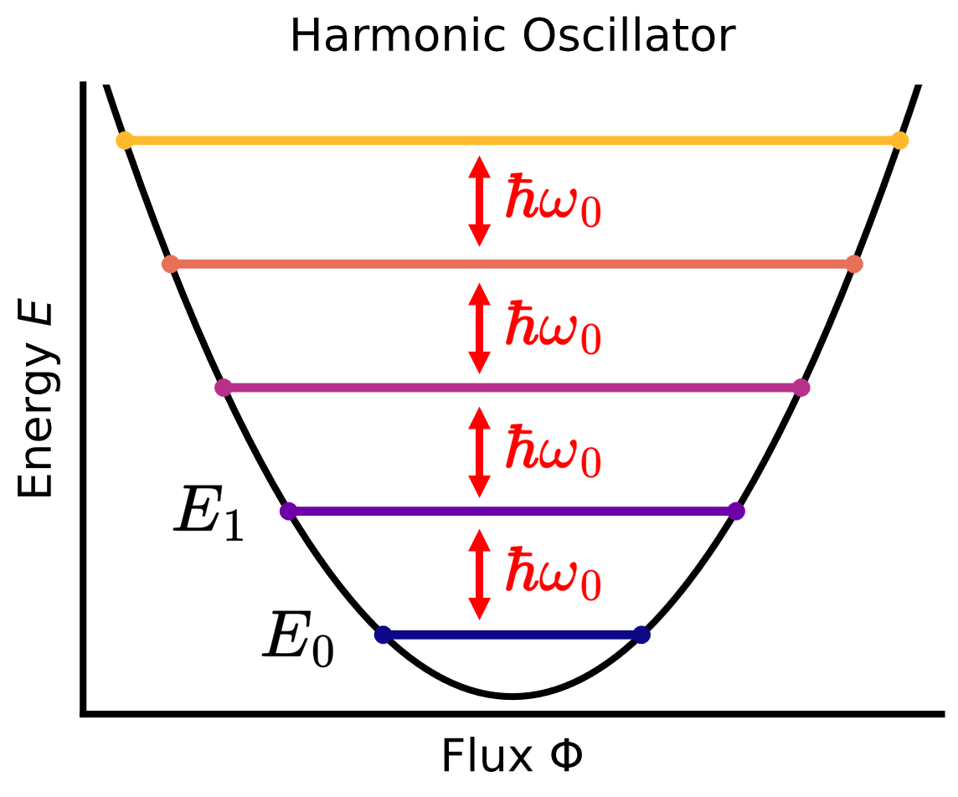
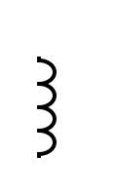


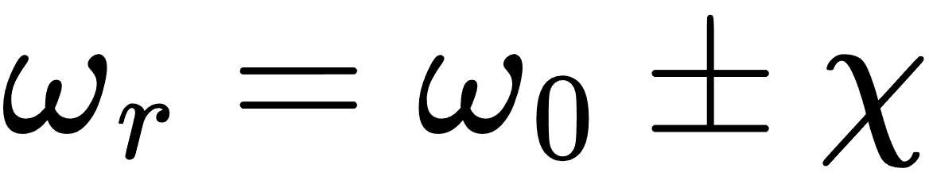
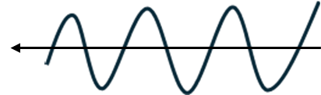
Harmonic oscillator to Qubit
?
?
?
Coherent
pulse
Plotted with scqubits
Koch, et al., Phys. Rev. A 76, 042319 (2007)

Slide 10
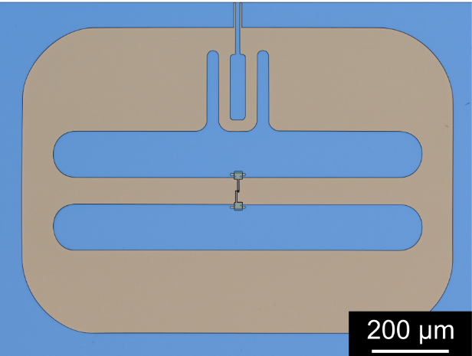
Transmon
Houck lab arXiv : 2003.00024
Koch, et al., Phys. Rev. A 76, 042319 (2007)

Slide 11
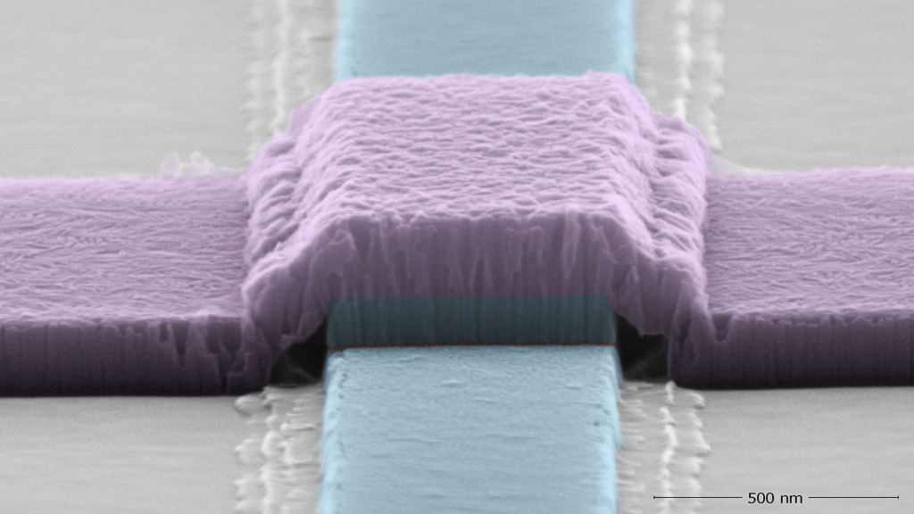

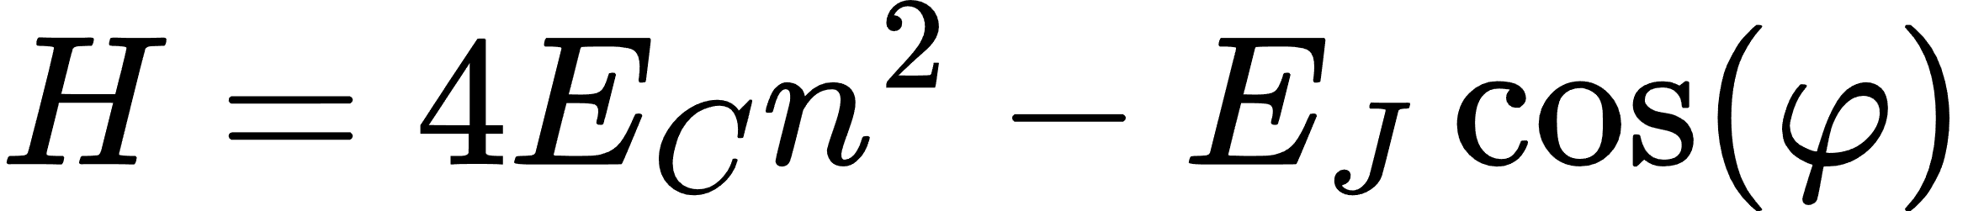
Josephson Junction
Tunnel Barrier
Superconductor
Al
AlOx
2e
2e
2e
Al
Superconductor
Source : NQISRC

Slide 12
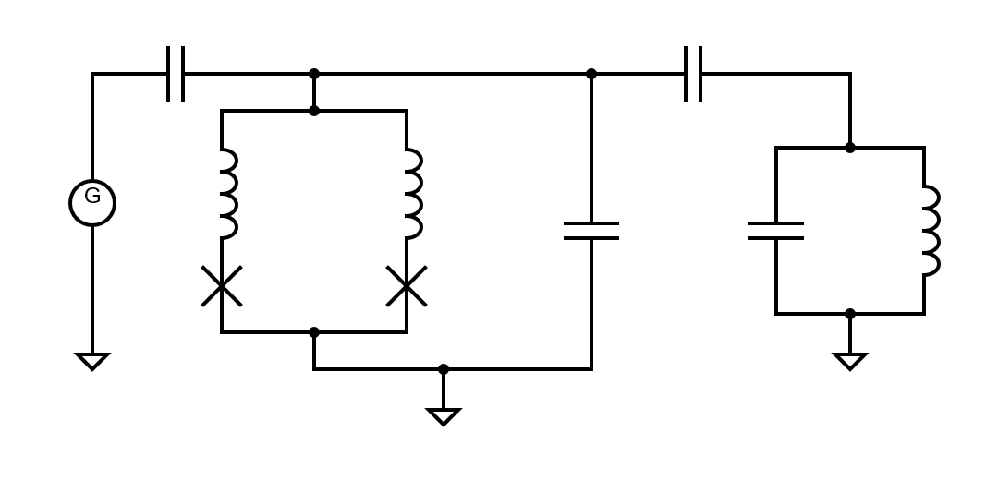
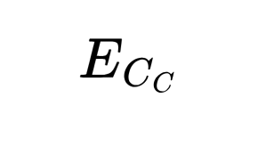
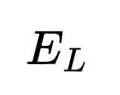
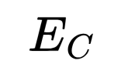

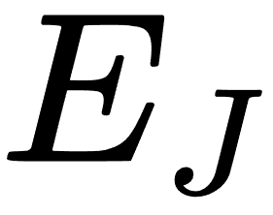
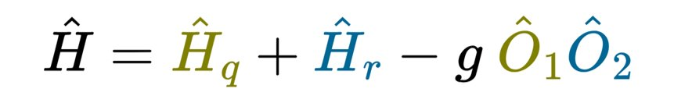
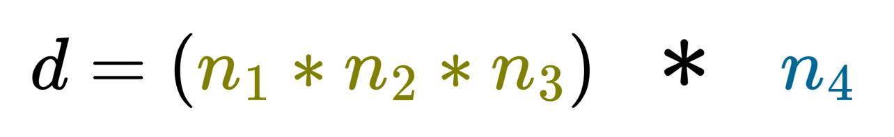
Kite Qubit
Smith, et al., Phys. Rev. X 12, 021002 (2022)

Slide 13
Kite Qubit
QUBIT
Smith, et al., Phys. Rev. X 12, 021002 (2022)

Slide 14
Kite Qubit
QUBIT (3 Modes)
Smith, et al., Phys. Rev. X 12, 021002 (2022)

Slide 15
Kite Qubit
QUBIT (3 Modes)
RESONATOR
Smith, et al., Phys. Rev. X 12, 021002 (2022)

Slide 16
Kite Qubit
QUBIT (3 Modes)
RESONATOR
Smith, et al., Phys. Rev. X 12, 021002 (2022)

Slide 17


Kite Qubit
QUBIT (3 Modes)
RESONATOR
Smith, et al., Phys. Rev. X 12, 021002 (2022)

Slide 18
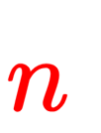
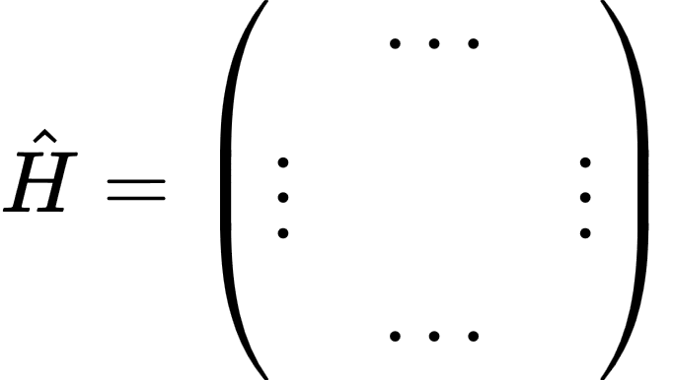
Motivations

Slide 19
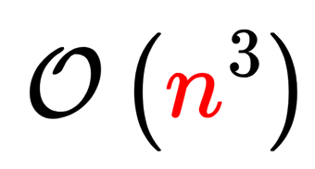
Motivations
Exact Diagonalization (ED) :

Slide 20
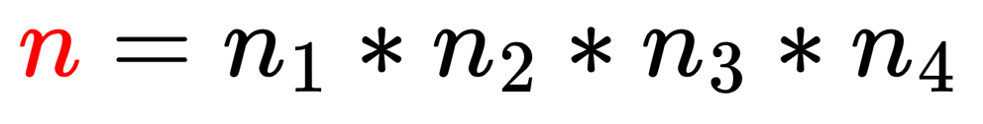
Motivations
Exact Diagonalization (ED) :
Recall that

Slide 21
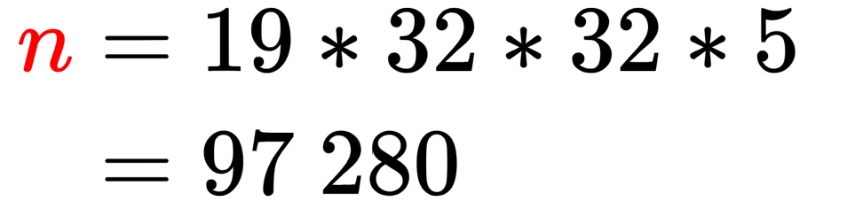
Motivations
Exact Diagonalization (ED) :
Recall that
For example,

Slide 22
Krylov Techniques

Slide 23
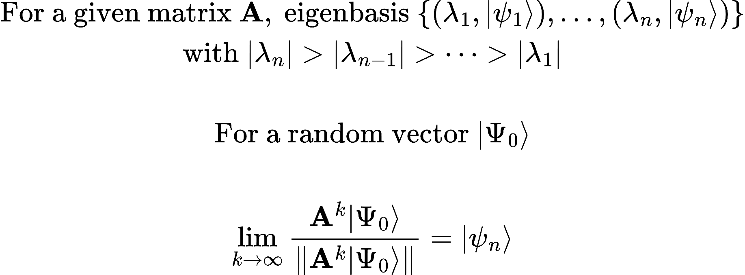
The power algorithm : Dominant Eigenspace

Slide 24
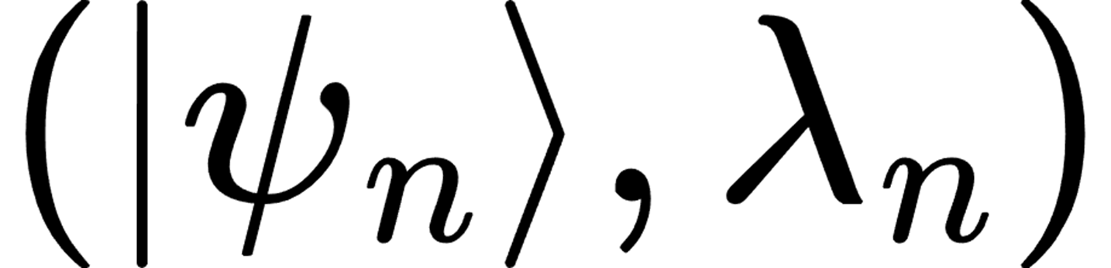
The power algorithm : Dominant Eigenspace
Power algorithm
Matrix

Slide 25
The power algorithm : Dominant Eigenspace
Power algorithm
Matrix
But : More interessed by lower energies

Slide 26
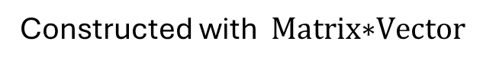
Krylov solver
Constructed with $\text{Matrix}\text{∗}\text{Vecto}\text{r}$

Slide 27
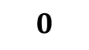
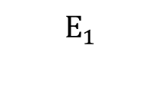

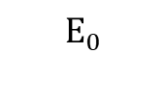
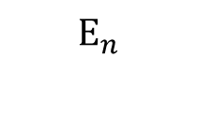


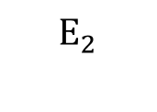
Krylov solver
Dominant Eigenvector
Constructed with $\text{Matrix}\text{∗}\text{Vecto}\text{r}$
$$E_{n}$$
$$E_{n−1}$$
$$E_{n−2}$$
Energy
$$\text{H}$$
…
$$E_{2}$$
$$E_{1}$$
$$E_{0}$$
$$0$$

Slide 28
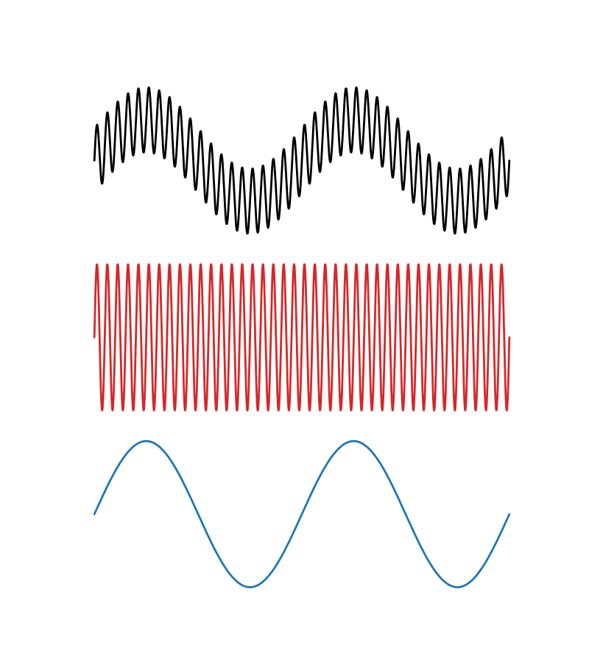
Krylov solver
Dominant Eigenvector
Constructed with $\text{Matrix}\text{∗}\text{Vecto}\text{r}$
$$E_{n}$$
$$E_{n−1}$$
$$E_{n−2}$$
-
Energy
$$\text{H}$$
…
$$E_{2}$$
$$E_{1}$$
=
$$E_{0}$$
$$0$$

Slide 29
Krylov solver
Dominant Eigenvector
Constructed with $\text{Matrix}\text{∗}\text{Vecto}\text{r}$
$$E_{n}$$
$$E_{n−1}$$
$$E_{n−2}$$
-
Energy
$$\text{H}$$
…
?
$$E_{2}$$
$$E_{1}$$
=
$$E_{0}$$
$$0$$

Slide 30
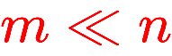
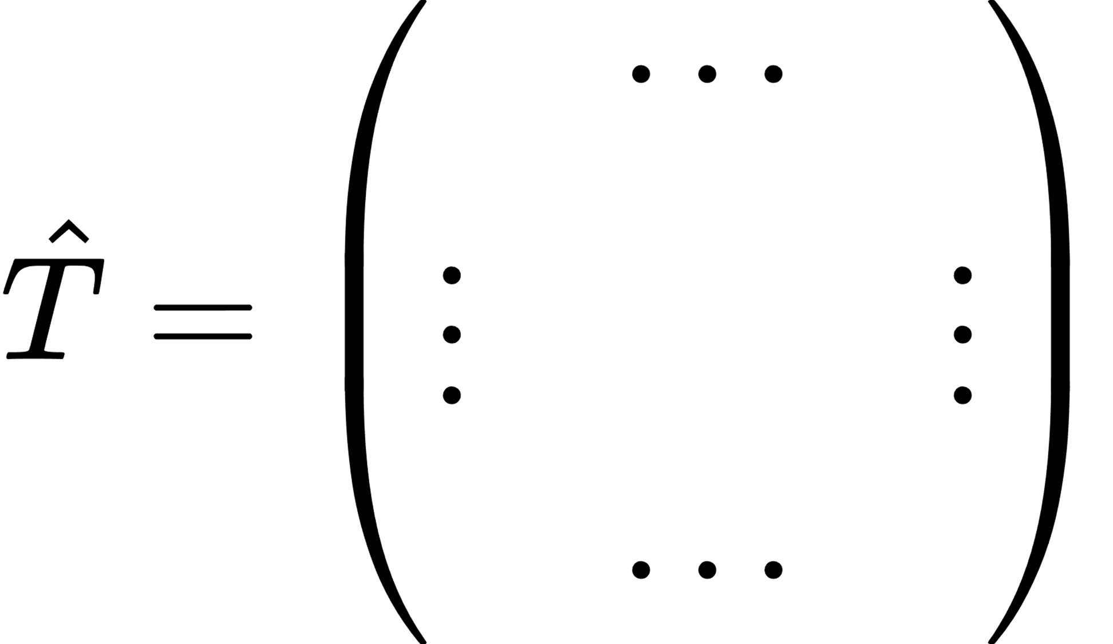

Krylov solver
Dominant Eigenvector
Constructed with $\text{Matrix}\text{∗}\text{Vecto}\text{r}$
$$E_{n}$$
$$E_{n−1}$$
$$E_{n−2}$$
-
Energy
$$\text{H}$$
…
?
$$E_{2}$$
$$E_{1}$$
=
$$E_{0}$$
$$0$$

Slide 31
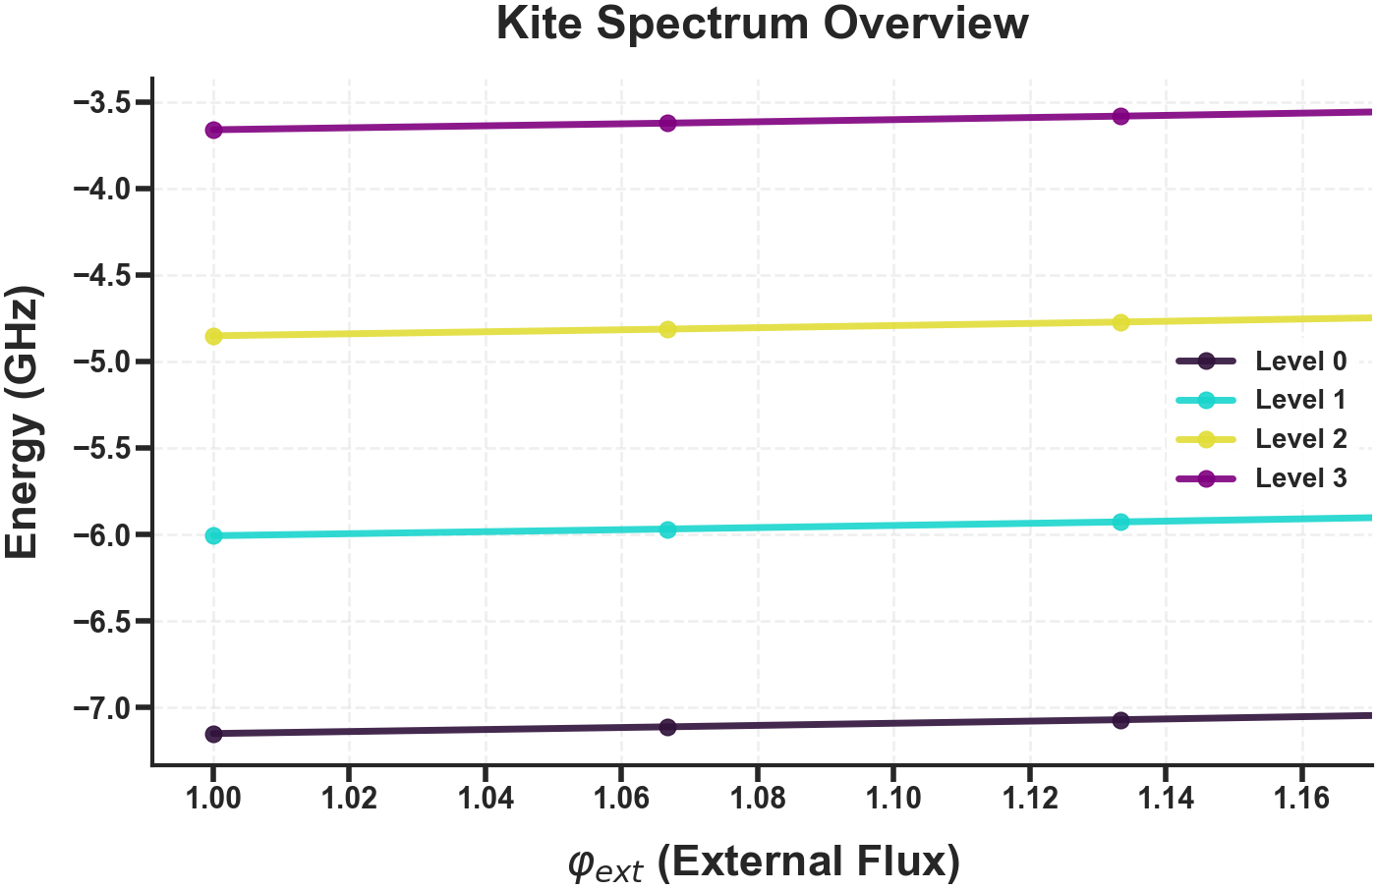
The idea

Slide 32
The idea
Lanczos computation
Aimed energy level to compute
New computation
New computation

Slide 33
The idea
Shift invert computation
Aimed energy level to compute
Using previous result

Slide 34
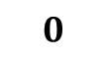


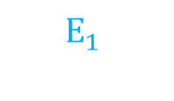
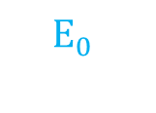
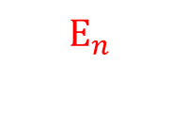

Shift Invert : conceptually
$E_{n }≃E$ : Mixed with other energies → propel it to the top of the spectrum
guess
$$E_{n+1}$$
$$E_{n}$$
Energy
$$\text{H}$$
$$E_{n−1}$$
…
$$E_{1}$$
$$E_{0}$$
$$0$$

Slide 35







Shift Invert : conceptually
$E_{n }≃E$ : Mixed with other energies → propel it to the top of the spectrum
guess
$$E_{n+1}$$
$$E_{n+1}−\text{E}$$
$$E_{n}$$
$$0$$
$$E_{n}−\text{E}$$
Energy
$$\text{H}$$
$$E_{n−1}$$
Energy
$$\text{H}−\text{E} \text{Id}$$
$$E_{n−1}−\text{E}$$
…
…
$$E_{1}$$
$$E_{1}−\text{E}$$
$$E_{0}$$
$$E_{0}−\text{E}$$
$$0$$

Slide 36




Shift Invert : conceptually
$E_{n }≃E$ : Mixed with other energies → propel it to the top of the spectrum
guess
$$E_{n+1}$$
$$E_{n+1}−\text{E}$$
$$\frac{1}{\text{δE}}$$
$$E_{n}$$
$$0$$
$$E_{n}−\text{E}$$
Energy
$$\text{H}$$
$$E_{n−1}$$
Energy
$$\text{H}−\text{E} \text{Id}$$
$$E_{n−1}−\text{E}$$
Energy
$${\left(\text{H}−\text{E} \text{Id}\right)}^{−1}$$
…
…
$$E_{1}$$
$$E_{1}−\text{E}$$
$$E_{0}$$
$$E_{0}−\text{E}$$
$$\frac{1}{{\text{E}}_{i}−\text{E}}$$
$$0$$
$$0$$

Slide 37
Shift Invert : conceptually
$E_{n }≃E$ : Mixed with other energies → propel it to the top of the spectrum
guess
Eigenvector ?
$$E_{n+1}$$
$$E_{n+1}−\text{E}$$
$$\frac{1}{\text{δE}}$$
$$E_{n}$$
$$0$$
$$E_{n}−\text{E}$$
Energy
$$\text{H}$$
$$E_{n−1}$$
Energy
$$\text{H}−\text{E} \text{Id}$$
$$E_{n−1}−\text{E}$$
Energy
$${\left(\text{H}−\text{E} \text{Id}\right)}^{−1}$$
…
…
$$E_{1}$$
$$E_{1}−\text{E}$$
$$E_{0}$$
$$E_{0}−\text{E}$$
$$\frac{1}{{\text{E}}_{i}−\text{E}}$$
$$0$$
$$0$$
${\left(\text{H}−\text{E} \text{Id}\right)}^{−1}$ computationally hard

Slide 38
Minres algorithm

Slide 39

Minres algorithm
Solvable with Minres
Krylov Solver $AX = Y$
A invertible

Slide 40

Minres algorithm
$$\frac{1}{\text{shift}}$$
Solvable with Minres
Krylov Solver $AX = Y$
A invertible
guess + shift

Slide 41






Minres algorithm
$$\frac{1}{\text{shift}}$$
Solvable with Minres
Krylov Solver $AX = Y$
A invertible
guess + shift

Slide 42

Minres algorithm
$$\frac{1}{\text{shift}}$$
Solvable with Minres
Krylov Solver $AX = Y$
A invertible
guess + shift
First order approximation

Slide 43
Minres algorithm
$$\frac{1}{\text{shift}}$$
Solvable with Minres
Krylov Solver $AX = Y$
A invertible
guess + shift

Slide 44

Self consistency accuracy check

Slide 45

Self consistency accuracy check

Slide 46

Self consistency accuracy check

Slide 47
Self consistency accuracy check
Choose carefully shift value

Slide 48

Shift Benchmark
Follow the lower branch for different shift values
…
Variance
Overlap
Computational time

Slide 49


Shift Benchmark
Follow the lower branch for different shift values
…
Variance
Overlap
Computational time
[GHz]
[GHz]

Slide 50
Shift Benchmark
Follow the lower branch for different shift values
…
Variance
Overlap
Computational time
Numerical error
[GHz]
[GHz]

Slide 51
Shift Benchmark
Follow the lower branch for different shift values
…
Variance
Overlap
Computational time
Numerical error
Sweet
spot
[GHz]
[GHz]

Slide 52

Shift Benchmark
Follow the lower branch for different shift values
…
Variance
Overlap
Computational time
Numerical error
Sweet
spot
$$shift≃ΔE$$
[GHz]
[GHz]

Slide 53




Final benchmark
n-th eigenvalue
1 step

Slide 54

Final benchmark
Varying parameters :
n
$Δφ$
n-th eigenvalue
Benchmark metrics :
Computation time
Variance
Overlap
1 step

Slide 55


Shift invert versus Lanczos

Slide 56
Conclusion
Usefull in very specific case
Could be optimized (Minres for complex Hamiltonian)
Cannot beat Lanczos when we want several eigenvalues

Slide 57
Tensor Networks & DMRG

Slide 58



Quick refresher on the problem

Slide 59

Quick refresher on the problem
$$ℋ →ℋ_{1}, ℋ_{2}, ℋ_{3}, ℋ_{4}$$

Slide 60


An Introduction to Tensor Networks
n-legged tensor
n-legged "blob"

Slide 61


Contraction:
Diagrams from tensornetwork.org

Slide 62

Can be represented by an order N tensor in a certain basis

Slide 63

Can be represented by an order N tensor in a certain basis

Slide 64





SVD
$$σ_{D+1}$$
Singular Values
Unitary

Slide 65

Tensor Trains, Matrix Product States (MPS)
Diagrams from tensornetwork.org

Slide 66



parameters
(instead of )
Diagrams from tensornetwork.org

Slide 67


Matrix Product Operator (MPO)
Diagrams from tensornetwork.org

Slide 68



Expected Values of the Hamiltonian
Diagram courtesy of E. Rui

Slide 69


DMRG
Global Optimisation Problem : Exponentially Hard
Numerous Smaller Local Optimisation Problems : Doable with Lanczos
Steven R. White, Phys. Rev. Lett. 69, 2863–2866 (1992)

Slide 71

$$φ$$

Slide 72


$$φ$$
$$φ_{Σ }$$
$$φ_{Δ }$$

Slide 73

$$φ$$
$$φ_{Σ }$$
$$φ_{Δ }$$
$$φ_{R }$$

Slide 74






$$φ$$
$$φ_{Σ }$$
$$φ_{Δ }$$
$$φ_{R }$$

Slide 75

$$φ$$
$$φ_{Σ }$$
$$φ_{Δ }$$
$$φ_{R }$$

Slide 76






$$φ$$
$$φ_{Σ }$$
$$φ_{Δ }$$
$$φ_{R }$$

Slide 77
$$φ$$
$$φ_{Σ }$$
$$φ_{Δ }$$
$$φ_{R }$$

Slide 78

$$φ$$
$$φ_{Σ }$$
$$φ_{Δ }$$
$$φ_{R }$$

Slide 79
$$φ$$
$$φ_{Σ }$$
$$φ_{Δ }$$
$$φ_{R }$$
Numerous meaningful singular values

Slide 80










$$\text{von} \text{Neumann} \text{Entropy} S_{VN} \text{vs} φ_{\text{ext}} \text{for} \text{first} \text{states}$$
Singular Values
$$\text{Entropy} S_{VN}$$
$$φ_{\text{ext}}$$
$$φ_{\text{ext}}$$
$$φ_{\text{ext}}$$
$$φ$$
$$φ_{Σ }$$
$$φ_{Δ }$$
$$φ_{R }$$

Slide 81
Openings
Sparse Matrices for faster arithmetic
DMRG-X to compute excited states faster
Better initial guesses
…

Slide 82
Annex Common Part

Slide 83




Transmon
Josephson with shunted capacitor

Slide 84

Transmon : wavefunctions
Simulated with different packages
Scqbits
Qutip
Numpy

Slide 85


Fluxonium

Slide 86




Transmon Readout
Input
Output
Transmon
Resonator
More photons
Decrease readout time (+)
Increase Hilbert space (-)
2 modes

Slide 87




Cross-Kerr : Measurement
Hamiltonian in the dispersive regime, i.e. , truncated to the first two levels (Blais et al., 2004) :
Dispersive shift
Eigenstates :
Eigenvalues :

Slide 88










Maximizing overlap
?

Slide 89

Dispersive shift 𝛘 as function of detuning 𝚫
Rm : Numerical Method uses QuTiP package and Exact Diagonalisation

Slide 90

Another Method

Slide 91

Kite Qubit Hamiltonian (no assymetry)

Slide 92
Annex Eliot

Slide 93

The power algorithm : Find the dominant eigenspace

Slide 94




Shift Invert

Slide 95


Follow trajectory, shift benchmark

Slide 96



…

Slide 97



Shift invert versus Lanczos different dim

Slide 98
Annex Gabriel

Slide 99




Why DMRG ?
Usual Tensor Representation: Memory Intensive
Tensor size :
MPS/MPO Representation: Efficient For Low-Entanglement Systems
Tensor size :
Diagrams courtesy of tensornetwork.org

Slide 100



DMRG
Contraction
Diagrams courtesy of E. Rui

Slide 101



Diagrams courtesy of E. Rui

Slide 102


Validating the results – The Hamiltonians
MPO, Julia
Compare trace, diagonals, coefficients and ultimately eigenvalues
Application, Python

Slide 103

Validating the results – The Energies
Dims: (9,16,16,5)

Slide 104



$$\text{V}\text{ariance} σ$$
(9, 16, 16, 5)
Vs
(19,32,32,5)
$$n_{\text{sweep}}$$

Slide 105


Computation Times
JAX Krylov Solver:
(9,16,16,5), for 4 states: ~3s
(19,32,32,5), for 4 states: ~20s
$$\text{Time}\text{ [}\text{s}\text{]}$$

Slide 106



Reordering Sites
$$φ_{R }$$
$$φ$$
$$φ_{Δ }$$
$$φ_{Σ }$$
5
9
16
16

Slide 107


New Computation Times
JAX Krylov Solver:
(9,16,16,5), for 4 states: ~3s
(19,32,32,5), for 4 states: ~20s
Julia DMRG Solver:
(9,16,16,5), for 4 states: ~6s
(19,32,32,5), for 4 states: ~40s
$$\text{Time}\text{ [}\text{s}\text{]}$$

Slide 108



$$\text{Time}\text{ [}\text{s}\text{]}$$
$$n_{\text{sweep}}$$

Slide 109



New Convergence
$$\text{V}\text{ariance} σ$$
$$n_{\text{sweep}}$$

Slide 110


